Slide 1


SCSA3016 DATA SCIENCE
UNIT-3
EXPLORATORY DATA ANALYSIS AND THE DATA SCIENCE PROCESS
C.KAVITHA
ASSISTANT PROFESSOR
DEPARTMENT OF CSE

Slide 2
SYLLABUS
UNIT 3 EXPLORATORY DATA ANALYSIS AND THE DATA SCIENCE PROCESS
Exploratory Data Analysis and the Data Science Process - Basic tools (plots, graphs and summary statistics) of EDA -Philosophy of EDA - The Data Science Process – Data Visualization - Basic principles, ideas and tools for data visualization - Examples of exciting projects- Data Visualization using Tableau.

Slide 3
TEXT / REFERENCE BOOKS
Cathy O’Neil and Rachel Schutt. Doing Data Science, Straight Talk From The Frontline. O’Reilly. 2014.
Introduction to Linear Algebra - By Gilbert Strang, Wellesley-Cambridge Press, 5th Edition.2016.
Applied Statistics and Probability For Engineers – By Douglas Montgomery.2016.
Jure Leskovek, Anand Rajaraman and Jeffrey Ullman. Mining of Massive Datasets. v2.1, Cambridge University Press. 2014. (free online)
Avrim Blum, John Hopcroft and Ravindran Kannan. Foundations of Data Science.
Jiawei Han, Micheline Kamber and Jian Pei. Data Mining: Concepts and Techniques, 3rd Edition. ISBN 0123814790, 2011.
Trevor Hastie, Robert Tibshirani and Jerome Friedman. Elements of Statistical Learning, 2nd Edition. ISBN 0387952845. 2009. (free online)

Slide 4
Exploratory Data Analysis (EDA)
Exploratory Data Analysis (EDA) is an approach to analyzing datasets to summarize their main characteristics, often with visual methods. EDA is used for seeing what the data can tell us before the modeling task.
EDA assists Data science professionals in various ways:-
1 Getting a better understanding of data 2 Identifying various data patterns 3 Getting a better understanding of the problem statement

Slide 5
The EDA is important to,
Detect outliers and anomalies
Determine the quality of data
Determine what statistical models can fit the data
Find out if the assumptions about the data, that you or your team started out with is correct or way off.
Extract variables or dimensions on which the data can be pivoted.
Determine whether to apply univariate or multivariate analytical techniques.
EDA is typically used for these four goals:
Exploring a single variable and looking at trends over time.
Checking data for errors.
Checking assumptions.
Looking at relationships between variables

Slide 6
Various exploratory data analysis methods like:
Descriptive Statistics, which is a way of giving a brief overview of the dataset we are dealing with, including some measures and features of the sample
Grouping data [Basic grouping with group by]
ANOVA, Analysis Of Variance, which is a computational method to divide variations in an observations set into different components.
Correlation and correlation methods

Slide 7
Descriptive Statistics
Descriptive statistics is a helpful way to understand characteristics of your data and to get a quick summary of it. Pandas in python provide an interesting method describe(). The describe function applies basic statistical computations on the dataset like extreme values, count of data points standard deviation etc. Any missing value or NaN value is automatically skipped. describe() function gives a good picture of distribution of data.

Slide 8
Grouping data
Group by is an interesting measure available in pandas which can help us figure out effect of different categorical attributes on other data variables.
Correlation and Correlation computation
Correlation is a simple relationship between two variables in a context such that one variable affects the other. Correlation is different from act of causing.

Slide 9
ANOVA
ANOVA stands for Analysis of Variance. It is performed to figure out the relation between the different group of categorical data.
Under ANOVA we have two measures as result: – F-testscore : which shows the variation of groups mean over variation – p-value: it shows the importance of the result
This can be performed using python module scipy method name f_oneway()

Slide 11
TYPES OF EDA
There are broadly two categories of EDA, graphical and non-graphical.
Univariate Non-graphical
Multivariate Non-graphical
Univariate graphical
Multivariate graphical
Univariate graphical: Non-graphical methods are quantitative and objective, they are doing not give the complete picture of the data; therefore, graphical methods are more involve a degree of subjective analysis, also are required.

Slide 12
Common sorts of univariate graphics are:
Histogram: The foremost basic graph is a histogram, which may be a barplot during which each bar represents the frequency (count) or proportion (count/total count) of cases for a variety of values. Histograms are one of the simplest ways to quickly learn a lot about your data, including central tendency, spread, modality, shape and outliers.
Stem-and-leaf plots: An easy substitute for a histogram may be stem-and-leaf plots. It shows all data values and therefore the shape of the distribution.
Boxplots: Another very useful univariate graphical technique is that the boxplot. Boxplots are excellent at presenting information about central tendency and show robust measures of location and spread also as providing information about symmetry and outliers, although they will be misleading about aspects like multimodality. One among the simplest uses of boxplots is within the sort of side-by-side boxplots.
Quantile-normal plots: The ultimate univariate graphical EDA technique is that the most intricate. it’s called the quantile-normal or QN plot or more generally the quantile-quantile or QQ plot. it’s wont to see how well a specific sample follows a specific theoretical distribution. It allows detection of non-normality and diagnosis of skewness and kurtosis

Slide 13
Univariate non-graphical
This is the simplest form of data analysis as during this we use just one variable to research the info. The standard goal of univariate non-graphical EDA is to know the underlying sample distribution/ data and make observations about the population. Outlier detection is additionally part of the analysis.

Slide 14
The characteristics of population distribution include:
Central tendency: The central tendency or location of distribution has got to do with typical or middle values. The commonly useful measures of central tendency are statistics called mean, median, and sometimes mode during which the foremost common is mean. For skewed distribution or when there’s concern about outliers, the median may be preferred.
Spread: Spread is an indicator of what proportion distant from the middle we are to seek out the find the info values. the quality deviation and variance are two useful measures of spread. The variance is that the mean of the square of the individual deviations and therefore the variance is the root of the variance
Skewness and kurtosis: Two more useful univariates descriptors are the skewness and kurtosis of the distribution. Skewness is that the measure of asymmetry and kurtosis may be a more subtle measure of peakedness compared to a normal distribution

Slide 15
Multivariate non-graphical
Multivariate non-graphical EDA technique is usually wont to show the connection between two or more variables within the sort of either cross-tabulation or statistics.
For categorical data, an extension of tabulation called cross-tabulation is extremely useful. For 2 variables, cross-tabulation is preferred by making a two-way table with column headings that match the amount of one-variable and row headings that match the amount of the opposite two variables, then filling the counts with all subjects that share an equivalent pair of levels.
For each categorical variable and one quantitative variable, we create statistics for quantitative variables separately for every level of the specific variable then compare the statistics across the amount of categorical variable.
Comparing the means is an off-the-cuff version of ANOVA and comparing medians may be a robust version of one-way ANOVA.

Slide 16
Multivariate graphical:
A graphical representation always gives you a better understanding of the relationship, especially among multiple variables.
Other common sorts of multivariate graphics are:
Scatterplot: For 2 quantitative variables, the essential graphical EDA technique is that the scatterplot , sohas one variable on the x-axis and one on the y-axis and therefore the point for every case in your dataset.

Slide 17
Run chart: It’s a line graph of data plotted over time.
Heat map: It’s a graphical representation of data where values are depicted by color.
Multivariate chart: It’s a graphical representation of the relationships between factors and response.
Bubble chart: It’s a data visualization that displays multiple circles (bubbles) in two-dimensional plot.

Slide 18
TOOLS in eda
The most commonly used software tools to perform EDA are Python and R.
Graphical exploratory data analysis employs visual tools to display data, such as:
Box plots
Box plots are used where there is a need to summarize data on an interval scale like the ones on the stock market, where ticks observed in one whole day may be represented in a single box, highlighting the lowest, highest, median and outliers.
Heatmap
Heatmaps are most often used for the representation of the correlation between variables. Here is an example of a heatmap.
As you can see from the chart, there is a strong correlation between density and residual sugar and absolutely no correlation between alcohol and residual sugar.
Histograms
The histogram is the graphical representation of numerical data that splits the data into ranges. The taller the bar, the greater the number of data points falling in that range. A good example here is the height data of a class of students. You would notice that the height data looks like a bell curves for a particular class with most the data lying within a certain range and a few of outside these ranges. There will be outliers too, either very short or very small.

Slide 19
Line graphs: one of the most basic types of charts that plots data points on a graph; has a wealth of uses in almost every field of study.
Pictograms: replace numbers with images to visually explain data. They’re common in the design of infographics, as well as visuals that data scientists can use to explain complex findings to non-data-scientist professionals and the public.
Scattergrams or scatterplots: typically used to display two variables in a set of data and then look for correlations among the data. For example, scientists might use it to evaluate the presence of two particular chemicals or gases in marine life in an effort to look for a relationship between the two variables.
Non-graphical exploratory data analysis involves data collection and reporting in nonvisual or non-pictorial formats.

Slide 20
Some of the most common data science tools used to create an EDA include:
Python: An interpreted, object-oriented programming language with dynamic semantics. Its high-level, built-in data structures, combined with dynamic typing and dynamic binding, make it very attractive for rapid application development, as well as for use as a scripting or glue language to connect existing components together. Python and EDA can be used together to identify missing values in a data set, which is important so you can decide how to handle missing values for machine learning.
R: An open-source programming language and free software environment for statistical computing and graphics supported by the R Foundation for Statistical Computing. The R language is widely used among statisticians in data science in developing statistical observations and data analysis.

Slide 21
Philosophy of EDA
Philosophy | EDA is not identical to statistical graphics although the two terms are used almost interchangeably. Statistical graphics is a collection of techniques--all graphically based and all focusing on one data characterization aspect. EDA encompasses a larger venue; EDA is an approach to data analysis that postpones the usual assumptions about what kind of model the data follow with the more direct approach of allowing the data itself to reveal its underlying structure and model. EDA is not a mere collection of techniques; EDA is a philosophy as to how we dissect a data set; what we look for; how we look; and how we interpret. It is true that EDA heavily uses the collection of techniques that we call "statistical graphics", but it is not identical to statistical graphics

Slide 22
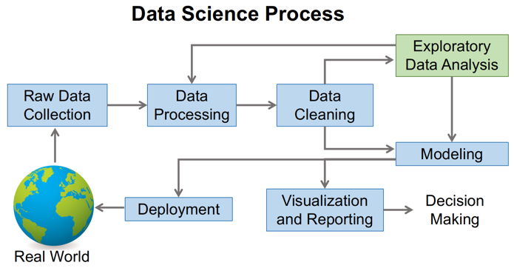
DATA SCIENCE PROCESS

Slide 23
Process of data science
The key steps involved in Data Science Modelling are:
Step 1: Understanding the Problem
Step 2: Data Extraction
Step 3: Data Cleaning
Step 4: Exploratory Data Analysis
Step 5: Feature Selection
Step 6: Incorporating Machine Learning Algorithms
Step 7: Testing the Models
Step 8: Deploying the Model

Slide 24
Step 1: Understanding the Problem
The first step involved in Data Science Modelling is understanding the problem. A Data Scientist listens for keywords and phrases when interviewing a line-of-business expert about a business challenge. The Data Scientist breaks down the problem into a procedural flow that always involves a holistic understanding of the business challenge, the Data that must be collected, and various Artificial Intelligence and Data Science approach that can be used to address the problem.

Slide 25
Step 2: Data Extraction
The next step in Data Science Modelling is Data Extraction. Not just any Data, but the Unstructured Data pieces you collect, relevant to the business problem you’re trying to address. The Data Extraction is done from various sources online, surveys, and existing Databases.
Gathering the data
Data is raw information, its the representation of both human and machine observation of the world. Dataset entirely depends on what type of problem you want to solve. Each problem in machine learning has its own unique approach.
Some website to get the dataset :
Kaggle: https://www.kaggle.com/datasets
UCI Machine Learning Repository: One of the oldest sources on the web to get the dataset. http://mlr.cs.umass.edu/ml/
This awesome GitHub repository has high-quality datasets. https://github.com/awesomedata/awesome-public-datasets

Slide 26
Step 3: Data Pre-processing and Cleaning
Steps In Data Preprocessing:
Gathering the data
Import the dataset & Libraries
Dealing with Missing Values
Divide the dataset into Dependent & Independent variable
dealing with Categorical values
Split the dataset into training and test set
Feature Scaling

Slide 27
Data cleaning on the other hand is the process of detecting, correcting and ensuring that your given data set is free from error, consistent and usable by identifying any errors or corruptions in the data, correcting or deleting them, or manually processing them as needed to prevent the error from corrupting our final analysis.
Data Cleaning is useful as you need to sanitize Data while gathering it. The following are some of the most typical causes of Data Inconsistencies and Errors:
Duplicate items are reduced from a variety of Databases.
The error with the input Data in terms of Precision.
Changes, Updates, and Deletions are made to the Data entries.
Variables with missing values across multiple Databases.

Slide 28
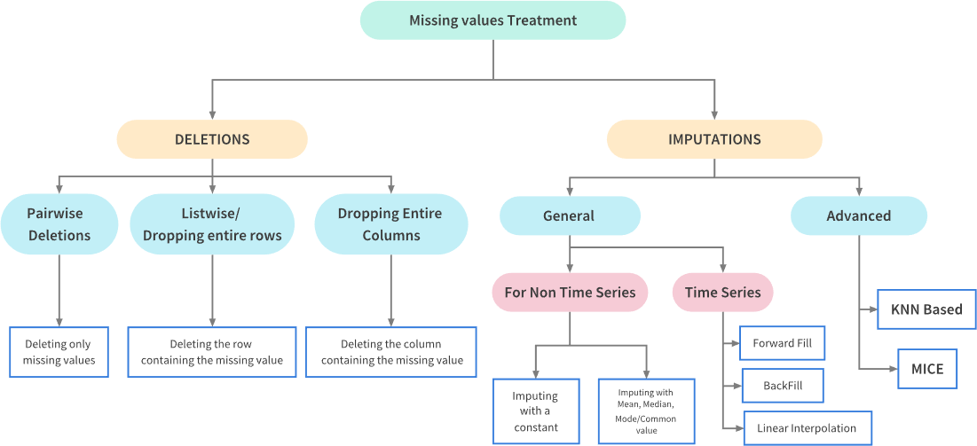
DATA CLEANING – MISSING VALUES

Slide 29
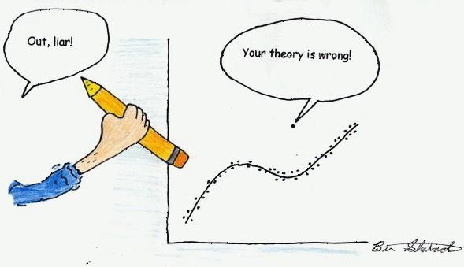
DATA CLEANING -OUTLIERS
What is an Outlier? – an anomaly – We will generally define outliers as samples that are exceptionally far from the mainstream of the data.
Outliers can have many causes, such as:
Measurement or input error
Data corruption
True outlier observation (e.g.., Michael Jordan in basketball)
Outlier can be in numeric, string, and date
String - E.g., City name is mentioned in a Country or gibberish data
Date – E.g., date appearing outside the period of analysis in scope

Slide 30
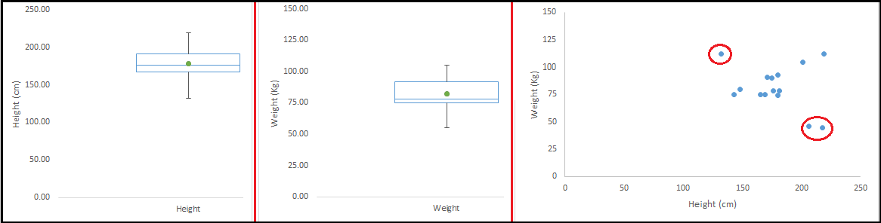
DATA CLEANING -OUTLIERS
Outlier can be
Univariate outliers - can be found when we look at distribution of a single variable
Multi-variate outliers - are found in n-dimensional space. E.g., understanding the relationship between
height and weight

Slide 31
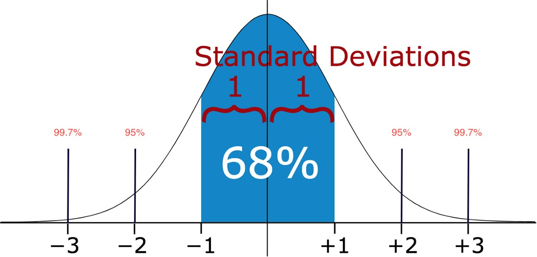
DATA CLEANING - OUTLIER DETECTION
Outlier detection methods – Numeric
Standard Deviation - If we know that the distribution of values in the sample is Gaussian or Gaussian-like, we can use the standard deviation of the sample as a cut-off for identifying outliers

Slide 32
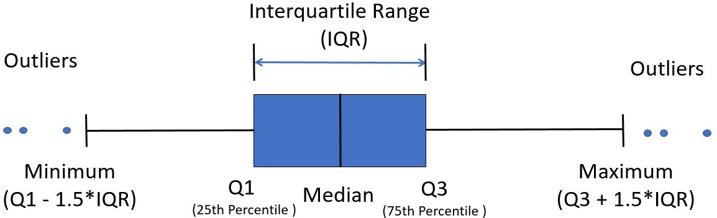
DATA CLEANING - OUTLIER DETECTION
Outlier detection methods – Numeric
Inter-Quartile Range (IQR) / Box-plot – IQR is a concept in statistics that is used to measure the statistical dispersion and data variability by dividing the dataset into quartiles.

Slide 33
DATA CLEANING – OUTLIER TREATMENT
Mean/Median or random imputation – same as missing value treatment
Dropping values – remove the observations with outliers - same as missing value treatment
Top, Bottom, and Zero Coding
Discretization (Binning)

Slide 34
DATA CLEANING –DUPLICATE DATA
Before removing duplicates form the data make sure
be sure they are not real data that coincidentally have values that are identical
try to figure why you have duplicates in your data (is it due to class imbalance?)

Slide 35
Feature Scaling
The final step of data preprocessing is to apply the very important feature scaling.
Feature Scaling is a technique to standardize the independent features present in the data in a fixed range. It is performed during the data pre-processing.
Why Scaling :- Most of the times, your dataset will contain features highly varying in magnitudes, units and range. But since, most of the machine learning algorithms use Euclidean distance between two data points in their computations, this is a problem.

Slide 36
Standardization and Normalization
Data Standardization and Normalization is a common practice in machine learning.
Standardization is another scaling technique where the values are centered around the mean with a unit standard deviation. This means that the mean of the attribute becomes zero and the resultant distribution has a unit standard deviation.
Normalization is a scaling technique in which values are shifted and rescaled so that they end up ranging between 0 and 1. It is also known as Min-Max scaling.

Slide 37
Step 4: Exploratory Data Analysis
Exploratory Data Analysis (EDA) is a robust technique for familiarising yourself with Data and extracting useful insights. Data Scientists sift through Unstructured Data to find patterns and infer relationships between Data elements. Data Scientists use Statistics and Visualisation tools to summarise Central Measurements and variability to perform EDA.

Slide 38
Step 5: Feature Selection
Feature Selection is the process of identifying and selecting the features that contribute the most to the prediction variable or output that you are interested in, either automatically or manually.
The presence of irrelevant characteristics in your Data can reduce the Model accuracy and cause your Model to train based on irrelevant features. In other words, if the features are strong enough, the Machine Learning Algorithm will give fantastic outcomes.
Two types of characteristics must be addressed:
Consistent characteristics that are unlikely to change.
Variable characteristics whose values change over time.

Slide 39
Step 6: Incorporating Machine Learning Algorithms
This is one of the most crucial processes in Data Science Modelling as the Machine Learning Algorithm aids in creating a usable Data Model. There are a lot of algorithms to pick from, the Model is selected based on the problem. There are three types of Machine Learning methods that are incorporated:
1) Supervised Learning
It is based on the results of a previous operation that is related to the existing business operation. Based on previous patterns, Supervised Learning aids in the prediction of an outcome. Some of the Supervised Learning Algorithms are:
Linear Regression
Random Forest
Support Vector Machines

Slide 40
2) Unsupervised Learning
This form of learning has no pre-existing consequence or pattern. Instead, it concentrates on examining the interactions and connections between the presently available Data points. Some of the Unsupervised Learning Algorithms are:
KNN (k-Nearest Neighbors)
K-means Clustering
Hierarchical Clustering
Anomaly Detection

Slide 41
3) Reinforcement Learning
It is a fascinating Machine Learning technique that uses a dynamic Dataset that interacts with the real world. In simple terms, it is a mechanism by which a system learns from its mistakes and improves over time. Some of the Reinforcement Learning Algorithms are:
Q-Learning
State-Action-Reward-State-Action (SARSA)
Deep Q Network

Slide 42
Step 7: Testing the Models
This is the next phase, and it’s crucial to check that our Data Science Modelling efforts meet the expectations. The Data Model is applied to the Test Data to check if it’s accurate and houses all desirable features. You can further test your Data Model to identify any adjustments that might be required to enhance the performance and achieve the desired results. If the required precision is not achieved, you can go back to Step 5 (Machine Learning Algorithms), choose an alternate Data Model, and then test the model again.
Step 8: Deploying the Model
The Model which provides the best result based on test findings is completed and deployed in the production environment whenever the desired result is achieved through proper testing as per the business needs.

Slide 43
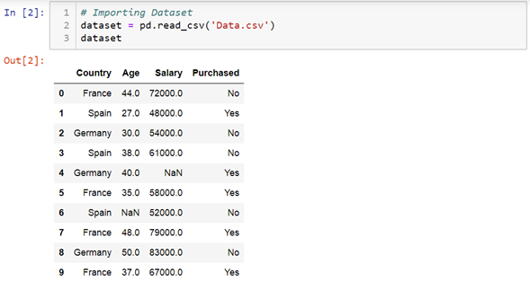
Example
Import the dataset & Libraries
First step is usually importing the libraries that will be needed in the program. A library is essentially a collection of modules that can be called and used.
Pandas offer tools for cleaning and process your data. It is the most popular Python library that is used for data analysis. In pandas, a data table is called a dataframe.

Slide 44
Dealing with Missing Values
Sometimes we may find some data are missing in the dataset. if we found then we will remove those rows or we can calculate either mean, mode or median of the feature and replace it with missing values. This is an approximation which can add variance to the dataset.
#Check for null values- dataset.isna() or dataset.isnull() to see the null values in dataset.
#Drop Null values- Pandas provide a dropna() function that can be used to drop either row or columns with missing data.
#Replacing Null values with Strategy: For replacing null values we use the strategy that can be applied on a feature which has numeric data. We can calculate the Mean, Median or Mode of the feature and replace it with the missing values.

Slide 45
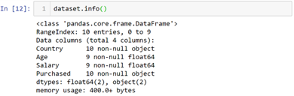
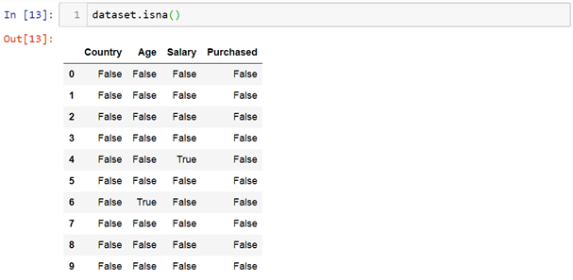
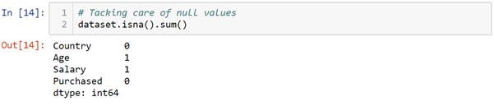

Slide 46
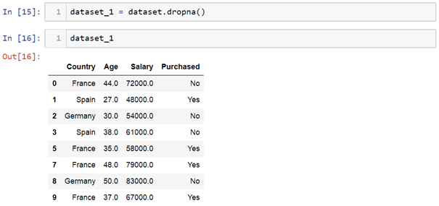
Drop Null values-
there is 4th and 6th index have null values. Now as above we can see both rows with missing data has been removed.

Slide 47
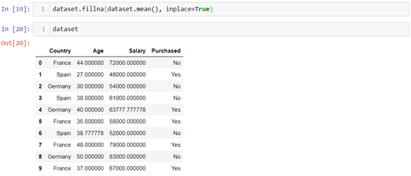
Replacing Null values

Slide 48
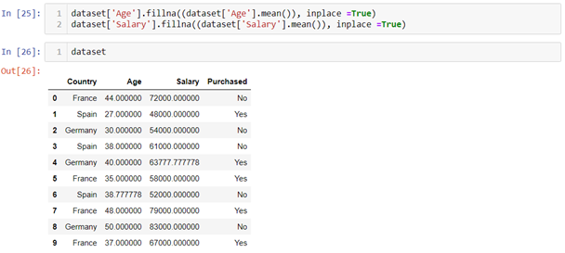
Replaces every variable null values with their respective mean, and ‘inplace =True’ indicates to affect the changes to dataset.

Slide 49
De-Duplicate means remove all duplicate values. There is no need for duplicate values in data analysis. These values only affect the accuracy and efficiency of the analysis result. To find duplicate values in the dataset we will use a simple dataframe function i.e. duplicated(). Let’s see the example:
dataset.duplicated()

Slide 50
Data Visualization
Data visualization is the process of translating large data sets and metrics into charts, graphs and other visuals.
The resulting visual representation of data makes it easier to identify and share real-time trends, outliers, and new insights about the information represented in the data.
Data visualization is one of the steps of the data science process, which states that after data has been collected, processed and modeled, it must be visualized for conclusions to be made.
Data visualization is also an element of the broader data presentation architecture (DPA) discipline, which aims to identify, locate, manipulate, format and deliver data in the most efficient way possible.

Slide 51
Data Visualization Tools
1. Tableau
It is a business intelligence service that aids people in visualizing as well as understanding their data it’s also one of those very widely used services in the field of business intelligence. It allows you to design an interactive reports dashboard and worksheets to obtain business visions it has outstanding visualization capabilities and has a great performance.
Pros:
Outstanding visual library
User friendly
Great performance
Connectivity to data
Powerful computation
Quick insights
Cons:
Inflexible pricing
No option for auto-refresh
Restrictive imports
Manual updates for static features

Slide 52
2. Power BI
Power BI, Microsoft's easy-to-use data visualization tool, is available for both on-premise installation and deployment on the cloud infrastructure. Power BI is one of the most complete data visualization tools that supports a myriad of backend databases, including Teradata, Salesforce, PostgreSQL, Oracle, Google Analytics, Github, Adobe Analytics, Azure, SQL Server, and Excel. The enterprise-level tool creates stunning visualizations and delivers real-time insights for fast decision-making.
The Pros of Power BI:
No requirement for specialized tech support
Easily integrates with existing applications
Personalized, rich dashboard
High-grade security
No speed or memory constraints
Compatible with Microsoft products
The Cons of Power BI:
Cannot work with varied, multiple datasets

Slide 53
3. Dundas BI
Dundas BI offers highly-customizable data visualizations with interactive scorecards, maps, gauges, and charts, optimizing the creation of ad-hoc, multi-page reports. By providing users full control over visual elements, Dundas BI simplifies the complex operation of cleansing, inspecting, transforming, and modeling big datasets.
The Pros of Dundas BI:
Exceptional flexibility
A large variety of data sources and charts
Wide range of in-built features for extracting, displaying, and modifying data
The Cons of Dundas BI:
No option for predictive analytics
3D charts not supported

Slide 54
4. JupyteR
A web-based application, JupyteR, is one of the top-rated data visualization tools that enable users to create and share documents containing visualizations, equations, narrative text, and live code. JupyteR is ideal for data cleansing and transformation, statistical modeling, numerical simulation, interactive computing, and machine learning.
The Pros of JupyteR:
Rapid prototyping
Visually appealing results
Facilitates easy sharing of data insights
The Cons of JupyteR:
Tough to collaborate
At times code reviewing becomes complicated

Slide 55
5. Zoho Reports
Zoho Reports, also known as Zoho Analytics, is a comprehensive data visualization tool that integrates Business Intelligence and online reporting services, which allow quick creation and sharing of extensive reports in minutes. The high-grade visualization tool also supports the import of Big Data from major databases and applications.
The Pros of Zoho Reports:
Effortless report creation and modification
Includes useful functionalities such as email scheduling and report sharing
Plenty of room for data
Prompt customer support.
The Cons of Zoho Reports:
User training needs to be improved
The dashboard becomes confusing when there are large volumes of data

Slide 56
6. GoogleCharts
One of the major players in the data visualization market space, Google Charts, coded with SVG and HTML5, is famed for its capability to produce graphical and pictorial data visualizations. Google Charts offers zoom functionality, and it provides users with unmatched cross-platform compatibility with iOS, Android, and even the earlier versions of the Internet Explorer browser.
The Pros of Google Charts:
User-friendly platform
Easy to integrate data
Visually attractive data graphs
Compatibility with Google products.
The Cons of Google Charts:
The export feature needs fine-tuning
Inadequate demos on tools
Lacks customization abilities
Network connectivity required for visualization

Slide 57
7. Sisense
Regarded as one of the most agile data visualization tools, Sisense gives users access to instant data analytics anywhere, at any time. The best-in-class visualization tool can identify key data patterns and summarize statistics to help decision-makers make data-driven decisions.
The Pros of Sisense:
Ideal for mission-critical projects involving massive datasets
Reliable interface
High-class customer support
Quick upgrades
Flexibility of seamless customization
The Cons of Sisense:
Developing and maintaining analytic cubes can be challenging
Does not support time formats
Limited visualization versions

Slide 58
8. Plotly
An open-source data visualization tool, Plotly offers full integration with analytics-centric programming languages like Matlab, Python, and R, which enables complex visualizations. Widely used for collaborative work, disseminating, modifying, creating, and sharing interactive, graphical data, Plotly supports both on-premise installation and cloud deployment.
The Pros of Plotly:
Allows online editing of charts
High-quality image export
Highly interactive interface
Server hosting facilitates easy sharing
The Cons of Plotly:
Speed is a concern at times
Free version has multiple limitations
Various screen-flashings create confusion and distraction

Slide 59
9. Data Wrapper
Data Wrapper is one of the very few data visualization tools on the market that is available for free. It is popular among media enterprises because of its inherent ability to quickly create charts and present graphical statistics on Big Data. Featuring a simple and intuitive interface, Data Wrapper allows users to create maps and charts that they can easily embed into reports.
The Pros of Data Wrapper:
Does not require installation for chart creation
Ideal for beginners
Free to use
The Cons of Data Wrapper:
Building complex charts like Sankey is a problem
Security is an issue as it is an open-source tool

Slide 60
10. QlikView
A major player in the data visualization market, Qlikview provides solutions to over 40,000 clients in 100 countries. Qlikview's data visualization tool, besides enabling accelerated, customized visualizations, also incorporates a range of solid features, including analytics, enterprise reporting, and Business Intelligence capabilities.
The Pros of QlikView:
User-friendly interface
Appealing, colorful visualizations
Trouble-free maintenance
A cost-effective solution
The Cons of QlikView:
RAM limitations
Poor customer support
Does not include the 'drag and drop' feature

Slide 61
Data Visualization with python
Python offers multiple great graphing libraries that come packed with lots of different features.
Here are a few popular plotting libraries:
Matplotlib: low level, provides lots of freedom
Pandas Visualization: easy to use interface, built on Matplotlib
Seaborn: high-level interface, great default styles
ggplot: based on R’s ggplot2, uses Grammar of Graphics
Plotly: can create interactive plots

Slide 62
Matplotlib
Matplotlib is a visualization library in Python for 2D plots of arrays. Matplotlib is written in Python and makes use of the NumPy library. It can be used in Python and IPython shells, Jupyter notebook, and web application servers. Matplotlib comes with a wide variety of plots like line, bar, scatter, histogram, etc. which can help us, deep-dive, into understanding trends, patterns, correlations. It was introduced by John Hunter in 2002.

Slide 63
Seaborn
Conceptualized and built originally at the Stanford University, this library sits on top of matplotlib. In a sense, it has some flavors of matplotlib while from the visualization point, its is much better than matplotlib and has added features as well. Below are its advantages
Built-in themes aid better visualization
Statistical functions aiding better data insights
Better aesthetics and built-in plots
Helpful documentation with effective examples

Slide 64
Bokeh
Bokeh is an interactive visualization library for modern web browsers. It is suitable for large or streaming data assets and can be used to develop interactive plots and dashboards. There is a wide array of intuitive graphs in the library which can be leveraged to develop solutions. It works closely with PyData tools. The library is well-suited for creating customized visuals according to required use-cases. The visuals can also be made interactive to serve a what-if scenario model. All the codes are open source and available on GitHub.

Slide 65
plotly
plotly.py is an interactive, open-source, high-level, declarative, and browser-based visualization library for Python. It holds an array of useful visualization which includes scientific charts, 3D graphs, statistical charts, financial charts among others. Plotly graphs can be viewed in Jupyter notebooks, standalone HTML files, or hosted online. Plotly library provides options for interaction and editing. The robust API works perfectly in both local and web browser mode.

Slide 66
ggplot
ggplot is a Python implementation of the grammar of graphics. The Grammar of Graphics refers to the mapping of data to aesthetic attributes (colour, shape, size) and geometric objects (points, lines, bars). The basic building blocks according to the grammar of graphics are data, geom (geometric objects), stats (statistical transformations), scale, coordinate system, and facet.
Using ggplot in Python allows you to develop informative visualizations incrementally, understanding the nuances of the data first, and then tuning the components to improve the visual representations.

Slide 67
Data Visualization in python using Seaborn
Box plot:
A box plot (or box-and-whisker plot) s is the visual representation of the depicting groups of numerical data through their quartiles against continuous/categorical data.
A box plot consists of 5 things.
Minimum
First Quartile or 25%
Median (Second Quartile) or 50%
Third Quartile or 75%
Maximum

Slide 68
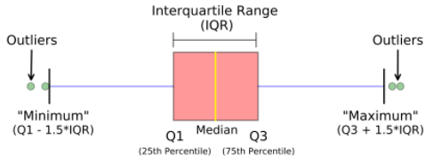
Representation of box plot.
Box plot representing multi-variate categorical variables

Slide 69
Syntax:
seaborn.boxplot(x=None, y=None, hue=None, data=None)
Parameters:
x, y, hue: Inputs for plotting long-form data.
data: Dataset for plotting. If x and y are absent, this is interpreted as wide-form.
Returns: It returns the Axes object with the plot drawn onto it.

Slide 70
Pandas and Seaborn is one of those packages and makes importing and analyzing data much easier.
# import module
import seaborn as sns
import pandas
# read csv and ploting
data = pandas.read_csv( "nba.csv" )
sns.boxplot( data['Age'] )

Slide 71
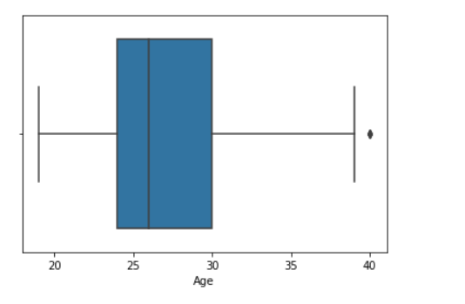

Slide 72
Example 2:
# import module
import seaborn as sns
import pandas
# read csv and ploting
data = pandas.read_csv( "nba.csv" )
sns.boxplot( data['Age'], data['Weight'])

Slide 73
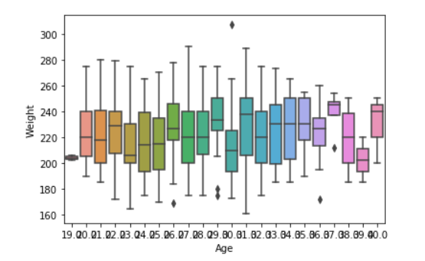

Slide 74
Voilin Plot:
A voilin plot is similar to a boxplot. It shows several quantitative data across one or more categorical variables such that those distributions can be compared.
Syntax: seaborn.violinplot(x=None, y=None, hue=None, data=None)
Parameters:
x, y, hue: Inputs for plotting long-form data.
data: Dataset for plotting.

Slide 75
# import module
import seaborn
seaborn.set(style = 'whitegrid')
# read csv and plot
data = pandas.read_csv("nba.csv")
seaborn.violinplot(x ="Age", y ="Weight",data = data)

Slide 76
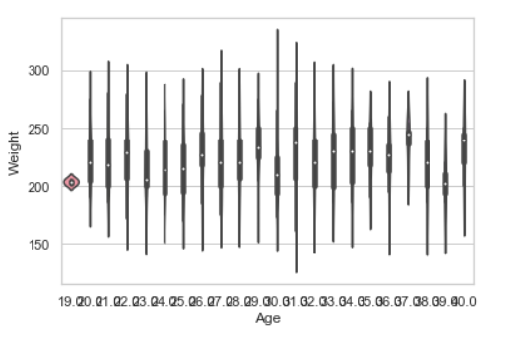

Slide 77
Line plot:
Lineplot Is the most popular plot to draw a relationship between x and y with the possibility of several semantic groupings.
Syntax : sns.lineplot(x=None, y=None)
Parameters:
x, y: Input data variables; must be numeric. Can pass data directly or reference columns in data.

Slide 78
# import module
import seaborn as sns
import pandas
# loading csv
data = pandas.read_csv("nba.csv")
# ploting lineplot
sns.lineplot( data['Age'], data['Weight'])

Slide 79
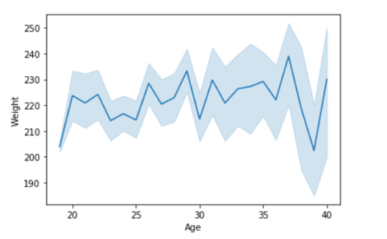

Slide 80
Example 2: Use the hue parameter for plotting the graph.
# import module
import seaborn as sns
import pandas
# read the csv data
data = pandas.read_csv("nba.csv")
# plot
sns.lineplot(data['Age'],data['Weight'], hue =data["Position"])

Slide 81
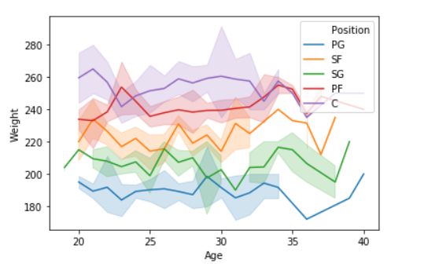

Slide 82
Scatter Plot
Scatter plots or scatter graphs is a bivariate plot having greater resemblance to line graphs in the way they are built.
Scatterplot Can be used with several semantic groupings which can help to understand well in a graph against continuous/categorical data. It can draw a two-dimensional graph.
Syntax: seaborn.scatterplot(x=None, y=None)
Parameters: x, y: Input data variables that should be numeric.
Returns: This method returns the Axes object with the plot drawn onto it.

Slide 83
Advantages of a scatter plot
Displays correlation between variables
Suitable for large data sets
Easier to find data clusters
Better representation of each data point

Slide 84
# import module
import seaborn
import pandas
# load csv
data = pandas.read_csv("nba.csv")
# plotting
seaborn.scatterplot(data['Age'],data['Weight'])

Slide 85
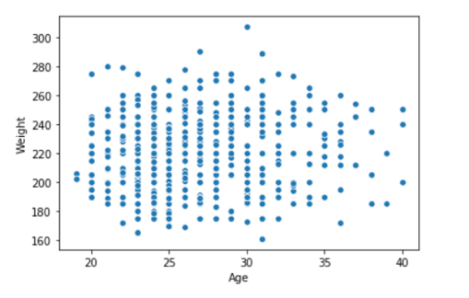

Slide 86
Example 2: Use the hue parameter for plotting the graph
import seaborn
import pandas
data = pandas.read_csv("nba.csv")
seaborn.scatterplot( data['Age'], data['Weight'], hue =data["Position"])

Slide 87
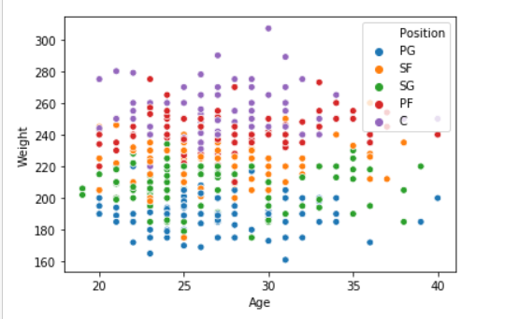

Slide 88
Bar plot:
Barplot represents an estimate of central tendency for a numeric variable with the height of each rectangle and provides some indication of the uncertainty around that estimate using error bars.
Syntax : seaborn.barplot(x=None, y=None, hue=None, data=None)
Parameters :
x, y : This parameter take names of variables in data or vector data, Inputs for plotting long-form data.
hue : (optional) This parameter take column name for colour encoding.
data : (optional) This parameter take DataFrame, array, or list of arrays, Dataset for plotting. If x and y are absent, this is interpreted as wide-form. Otherwise it is expected to be long-form.
Returns : Returns the Axes object with the plot drawn onto it.

Slide 89
# import module
import seaborn
seaborn.set(style = 'whitegrid')
# read csv and plot
data = pandas.read_csv("nba.csv")
seaborn.barplot(x =data["Age"])

Slide 90
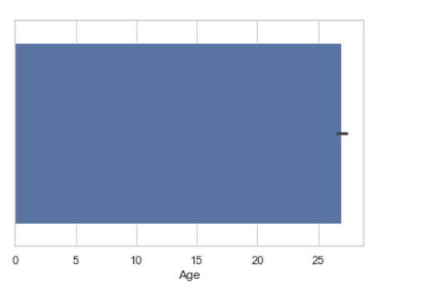

Slide 91
Example 2
# import module
import seaborn
seaborn.set(style = 'whitegrid')
# read csv and plot
data = pandas.read_csv("nba.csv")
seaborn.barplot(x ="Age", y ="Weight", data = data)

Slide 92
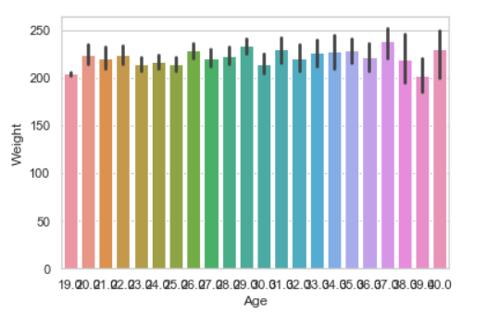

Slide 93
Point plot:
Point plot used to show point estimates and confidence intervals using scatter plot glyphs. A point plot represents an estimate of central tendency for a numeric variable by the position of scatter plot points and provides some indication of the uncertainty around that estimate using error bars.
Syntax: seaborn.pointplot(x=None, y=None, hue=None, data=None)
Parameters:
x, y: Inputs for plotting long-form data.
hue: (optional) column name for color encoding.
data: dataframe as a Dataset for plotting.
Return: The Axes object with the plot drawn onto it.

Slide 94
# import module
import seaborn
seaborn.set(style = 'whitegrid')
# read csv and plot
data = pandas.read_csv("nba.csv")
seaborn.pointplot(x = "Age", y = "Weight", data = data)

Slide 95
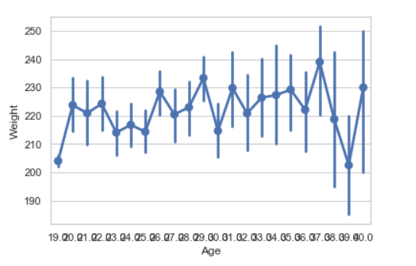

Slide 96
Countplot
A countplot is a plot between a categorical and a continuous variable. The continuous variable in this case being the number of times the categorical is present or simply the frequency. In a sense, count plot can be said to be closely linked to a histogram or a bar graph.

Slide 97
Syntax : seaborn.countplot(x=None, y=None, hue=None, data=None)
Parameters :
x, y: This parameter take names of variables in data or vector data, optional, Inputs for plotting long-form data.
hue : (optional) This parameter take column name for color encoding.
data : (optional) This parameter take DataFrame, array, or list of arrays, Dataset for plotting. If x and y are absent, this is interpreted as wide-form. Otherwise, it is expected to be long-form.
Returns: Returns the Axes object with the plot drawn onto it.

Slide 98
# import module
import seaborn
seaborn.set(style = 'whitegrid')
# read csv and plot
data = pandas.read_csv("nba.csv")
seaborn.countplot(data["Age"])

Slide 99
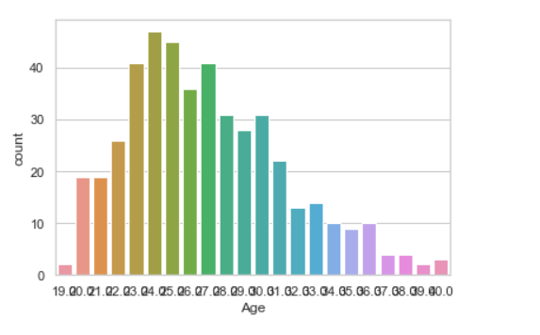
Output Countplot

Slide 100
Bivariate and Univariate data using seaborn and pandas:
Bivariate data: This type of data involves two different variables. The analysis of this type of data deals with causes and relationships and the analysis is done to find out the relationship between the two variables.
Univariate data: This type of data consists of only one variable. The analysis of univariate data is thus the simplest form of analysis since the information deals with only one quantity that changes. It does not deal with causes or relationships and the main purpose of the analysis is to describe the data and find patterns that exist within it.

Slide 101
Example 1: example of Bivariate data disturbation
Using the box plot.
# import module
import seaborn as sns
import pandas
# read csv and ploting
data = pandas.read_csv( "nba.csv" )
sns.boxplot( data['Age'], data['Height'])

Slide 102
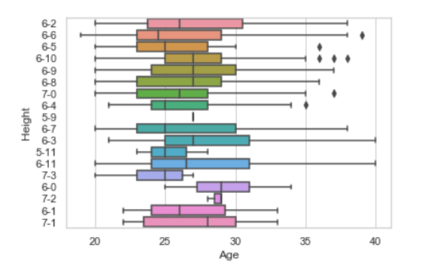

Slide 103
Let’s see an example of univariate data distribution:
Example: Using the dist plot
# import module
import seaborn as sns
import pandas
# read top 5 column
data = pandas.read_csv("nba.csv").head()
sns.distplot( data['Age'])

Slide 104
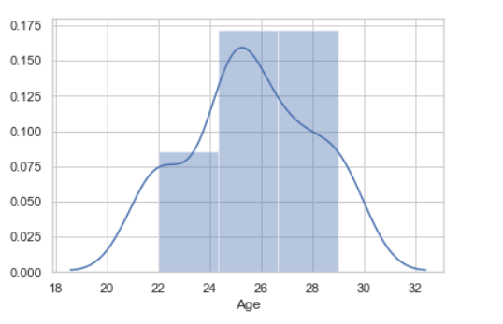

Slide 105
Correlation heatmap
A correlation heatmap is a heatmap that shows a 2D correlation matrix between two discrete dimensions, using colored cells to represent data from usually a monochromatic scale. The values of the first dimension appear as the rows of the table while of the second dimension as a column.
The color of the cell is proportional to the number of measurements that match the dimensional value. This makes correlation heatmaps ideal for data analysis since it makes patterns easily readable and highlights the differences and variation in the same data.
A correlation heatmap, like a regular heatmap, is assisted by a colorbar making data easily readable and comprehensible.

Slide 106
Syntax: heatmap(data, vmin, vmax, center, cmap,……………………………………………………)
Example:
For the example given below, here a dataset downloaded from kaggle.com is being used. The plot shows data related to bestseller novels on amazon.

Slide 107
# import modules
import matplotlib.pyplot as mp
import pandas as pd
import seaborn as sb
# import file with data
data = pd.read_csv(‘bestsellers.csv’)
# prints data that will be plotted
# columns shown here are selected by corr() since
# they are ideal for the plot
print(data.corr())
# plotting correlation heatmap
dataplot = sb.heatmap(data.corr(), cmap="YlGnBu", annot=True)
# displaying heatmap
mp.show()

Slide 108
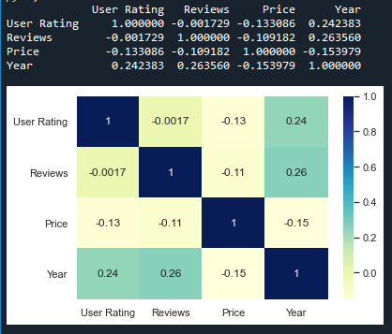

Slide 109
Histogram
Histograms display counts of data and are hence similar to a bar chart. A histogram plot can also tell us how close a data distribution is to a normal curve. While working out statistical method, it is very important that we have a data which is normally or close to a normal distribution. However, histograms are univariate in nature and bar charts bivariate.
A bar graph charts actual counts against categories e.g. height of the bar indicates the number of items in that category whereas a histogram displays the same categorical variables in bins.
Bins are integral part while building a histogram they control the data points which are within a range. As a widely accepted choice we usually limit bin to a size of 5-20, however this is totally governed by the data points which is present.

Slide 110
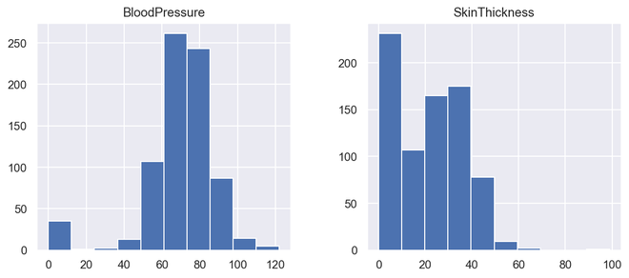
Example: Diabetes dataset
# illustrate histogram
features = ['BloodPressure', 'SkinThickness']
diabetes[features].hist(figsize=(10, 4))

Slide 111
Some examples using Matplotlib
Bar chart using Matplotlib-Titanic dataset
#Creating the dataset
df = sns.load_dataset('titanic')
df=df.groupby('who')['fare'].sum().to_frame().reset_index()
#Creating the bar chart
plt.barh(df['who'],df['fare'],color = ['#F0F8FF','#E6E6FA','#B0E0E6'])
#Adding the aesthetics
plt.title('Chart title')
plt.xlabel('X axis title')
plt.ylabel('Y axis title')
#Show the plot
plt.show()

Slide 112
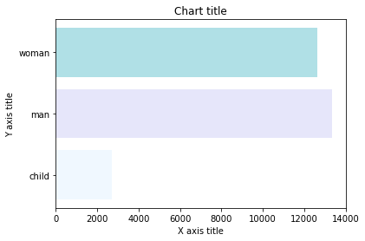

Slide 113
Line chart using Matplotlib- Iris Dataset
#Creating the dataset
df = sns.load_dataset("iris")
df=df.groupby('sepal_length')['sepal_width'].sum().to_frame().reset_index()
#Creating the line chart
plt.plot(df['sepal_length'], df['sepal_width'])
#Adding the aesthetics
plt.title('Chart title')
plt.xlabel('X axis title')
plt.ylabel('Y axis title')
#Show the plot
plt.show()

Slide 114
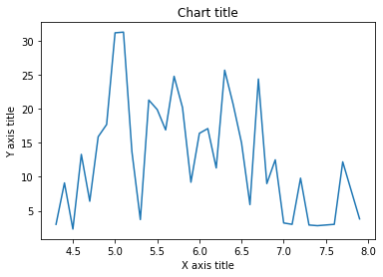

Slide 115
Examples of exciting projects- Exploratory Data Analysis : Iris Dataset
Importing relevant libraries
import pandas as pd import numpy as np import matplotlib.pyplot as plt import seaborn as sns from sklearn import metrics sns.set()

Slide 116
Source Of Data
Data has been stored inside a csv file namely ‘iris.csv’
Loading data
iris_data = pd.read_csv(‘iris.csv’) iris_data

Slide 117
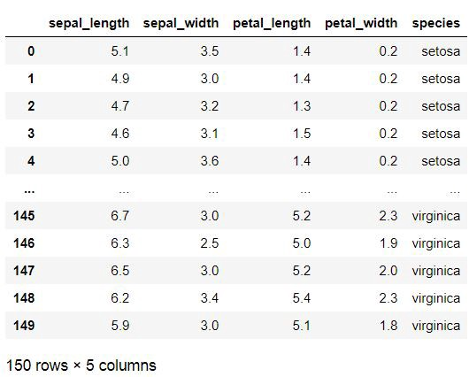

Slide 118
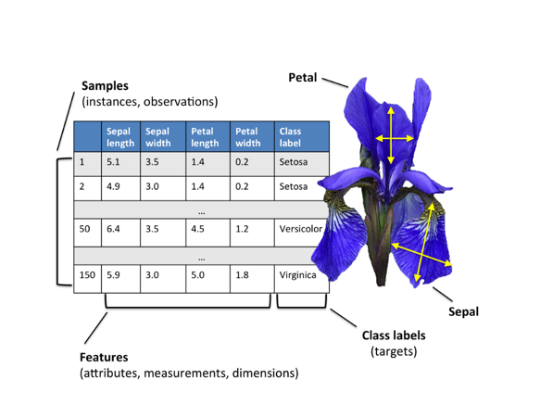

Slide 119
Getting Information about the Dataset
We will use the shape parameter to get the shape of the dataset.
iris_data.shape
Output:
(150, 6)We can see that the dataframe contains 6 columns and 150 rows.

Slide 120
Gaining information from data
iris_data.info()
<class 'pandas.core.frame.DataFrame'> RangeIndex: 150 entries, 0 to 149 Data columns (total 5 columns): # Column Non-Null Count Dtype --- ------ -------------- ----- 0 sepal_length 150 non-null float64 1 sepal_width 150 non-null float64 2 petal_length 150 non-null float64 3 petal_width 150 non-null float64 4 species 150 non-null object dtypes: float64(4), object(1) memory usage: 6.0+ KB
We can see that only one column has categorical data and all the other columns are of the numeric type with non-Null entries.

Slide 121
Data Insights:
1 All columns are not having any Null Entries
2 Four columns are numerical type
3 Only Single column categorical type

Slide 122
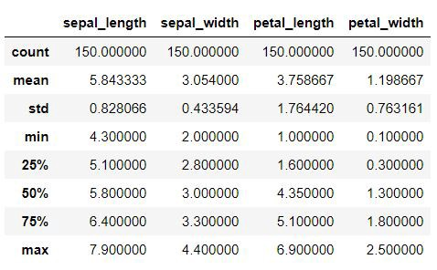
Statistical Insight
iris_data.describe()
Statistical Insight
iris_data.describe()

Slide 123
Data Insights:
Mean values
Standard Deviation ,
Minimum Values
Maximum Values

Slide 124
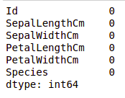
Checking Missing Values
We will check if our data contains any missing values or not. Missing values can occur when no information is provided for one or more items or for a whole unit. We will use the isnull() method.
iris_data.isnull().sum()
We can see that no column as any missing value.

Slide 125
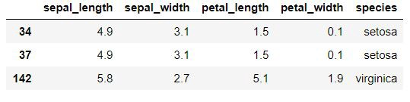
Checking For Duplicate Entries
iris_data[iris_data.duplicated()]
There are 3 duplicates, therefore we must check whether each species data set is balanced in no's or no

Slide 126
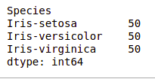
Checking the balance
iris_data[‘species’].value_counts()
Therefore we shouldn’t delete the entries as it might imbalance the data sets and hence will prove to be less useful for valuable insights

Slide 127
Data Visualization
Visualizing the target column
Our target column will be the Species column because at the end we will need the result according to the species only. Note: We will use Matplotlib and Seaborn library for the data visulalization.

Slide 128
# importing packages
import seaborn as sns
import matplotlib.pyplot as plt
plt.title(‘Species Count’) sns.countplot(iris_data[‘species’])

Slide 129
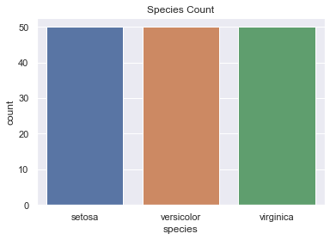

Slide 130

Data Insight:
This further visualizes that species are well balanced
Each species ( Iris virginica, setosa, versicolor) has 50 as it’s count
Iris Flower Species

Slide 131
Uni-variate Analysis
Comparison between various species based on sepal length and width
plt.figure(figsize=(17,9)) plt.title(‘Comparison between various species based on sapel length and width’) sns.scatterplot(iris_data[‘sepal_length’],iris_data[‘sepal_width’],hue =iris_data[‘species’],s=50)

Slide 132
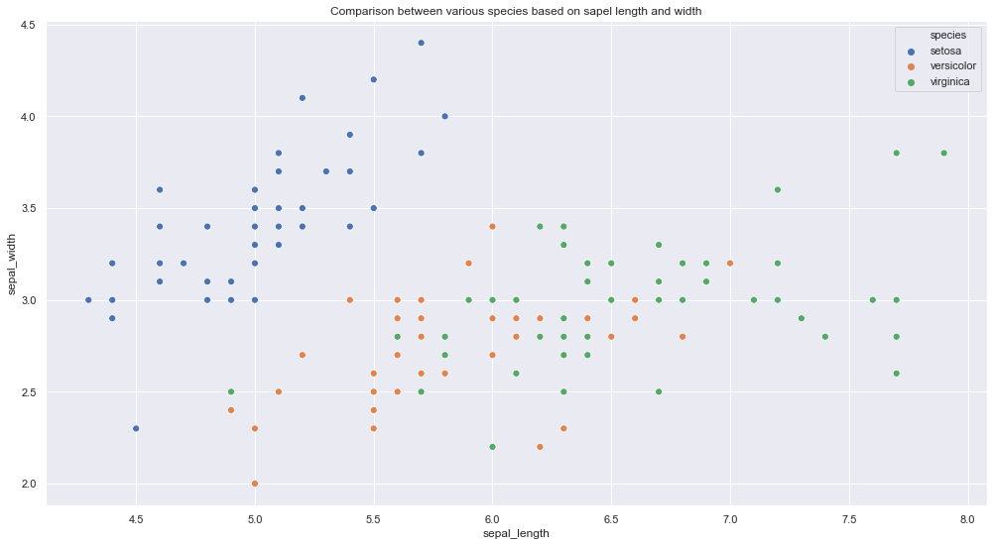

Slide 133
Data Insights:
Iris Setosa species has smaller sepal length but higher width.
Versicolor lies in almost middle for length as well as width
Virginica has larger sepal lengths and smaller sepal widths
Comparison between various species based on petal length and width
plt.figure(figsize=(16,9)) plt.title(‘Comparison between various species based on petal lenght and width’) sns.scatterplot(iris_data[‘petal_length’], iris_data[‘petal_width’], hue = iris_data[‘species’], s= 50)

Slide 134
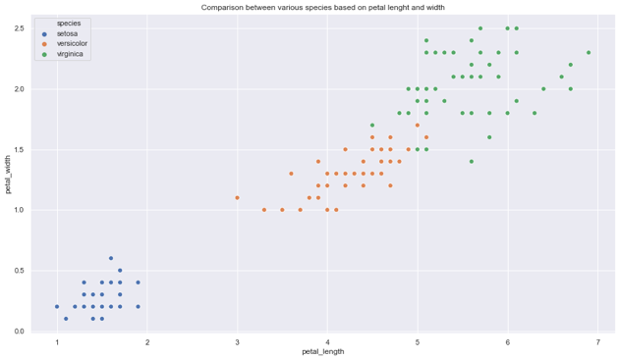

Slide 135
Data Insights
Setosa species have the smallest petal length as well as petal width
Versicolor species have average petal length and petal width
Virginica species have the highest petal length as well as petal width

Slide 136
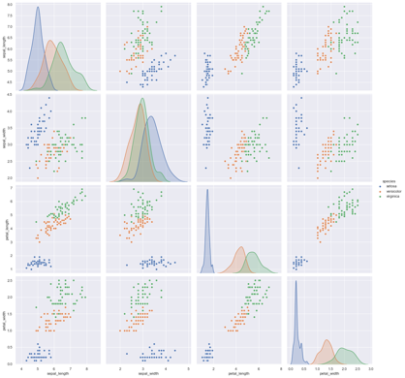
Let’s plot all the column’s relationships using a pairplot. It can be used for multivariate analysis.
sns.pairplot(iris_data,hue=”species”,height=4)

Slide 137
Data Insights:
High co relation between petal length and width columns.
Setosa has both low petal length and width
Versicolor has both average petal length and width
Virginica has both high petal length and width.
Sepal width for setosa is high and length is low.
Versicolor have average values for for sepal dimensions.
Virginica has small width but large sepal length

Slide 138
The heatmap is a data visualization technique that is used to analyze the dataset as colors in two dimensions. Basically, it shows a correlation between all numerical variables in the dataset. In simpler terms, we can plot the above-found correlation using the heatmaps.
Checking Correlation
plt.figure(figsize=(10,11)) sns.heatmap(iris_data.corr(),annot=True) plt.plot()

Slide 139
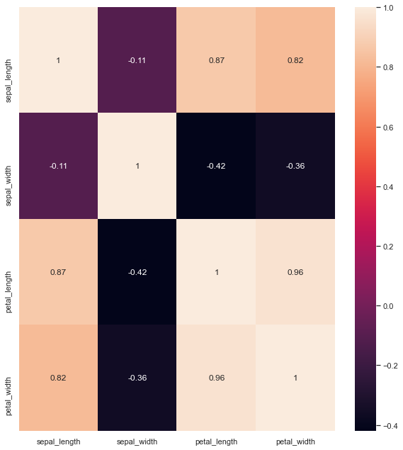
Heatmap

Slide 140
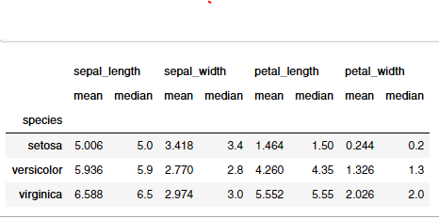
Data Insights:
Sepal Length and Sepal Width features are slightly correlated with each other
Checking Mean & Median Values for each species
iris.groupby(‘species’).agg([‘mean’, ‘median’])
mean and median
outputs
visualizing the distribution , mean and median using box plots & violin plots

Slide 141
Box plots to know about distribution
boxplot to see how the categorical feature “Species” is distributed with all other four input variables
fig, axes = plt.subplots(2, 2, figsize=(16,9)) sns.boxplot( y=”petal_width”, x= “species”, data=iris_data, orient=’v’ , ax=axes[0, 0]) sns.boxplot( y=”petal_length”, x= “species”, data=iris_data, orient=’v’ , ax=axes[0, 1]) sns.boxplot( y=”sepal_length”, x= “species”, data=iris_data, orient=’v’ , ax=axes[1, 0]) sns.boxplot( y=”sepal_width”, x= “species”, data=iris_data, orient=’v’ , ax=axes[1, 1]) plt.show()

Slide 142
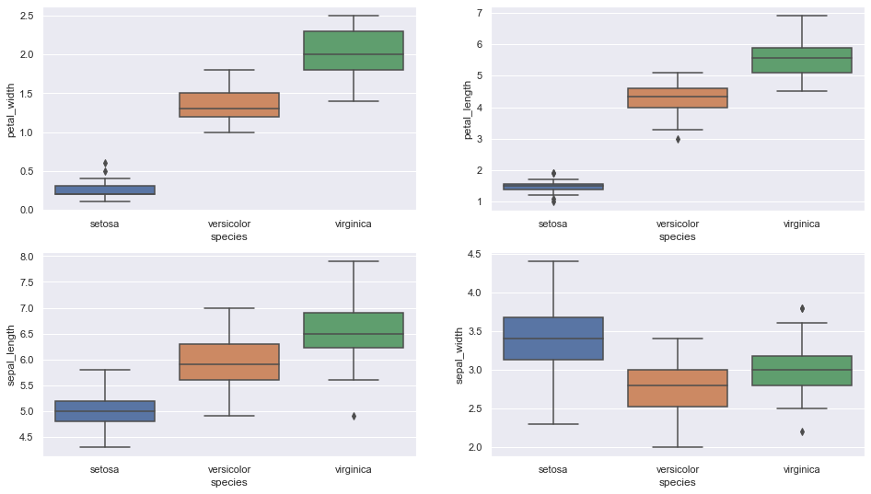

Slide 143
Data Insights:
Setosa is having smaller feature and less distributed
Versicolor is distributed in a average manner and average features
Virginica is highly distributed with large no .of values and features
Clearly the mean/ median values are being shown by each plots for various features(sepal length & width, petal length & width)

Slide 144
Violin Plot for checking distribution
The violin plot shows density of the length and width in the species. The thinner part denotes that there is less density whereas the fatter part conveys higher density
fig, axes = plt.subplots(2, 2, figsize=(16,10)) sns.violinplot( y=”petal_width”, x= “species”, data=iris_data, orient=’v’ , ax=axes[0, 0],inner=’quartile’) sns.violinplot( y=”petal_length”, x= “species”, data=iris_data, orient=’v’ , ax=axes[0, 1],inner=’quartile’) sns.violinplot( y=”sepal_length”, x= “species”, data=iris_data, orient=’v’ , ax=axes[1, 0],inner=’quartile’) sns.violinplot( y=”sepal_width”, x= “species”, data=iris_data, orient=’v’ , ax=axes[1, 1],inner=’quartile’) plt.show()

Slide 145
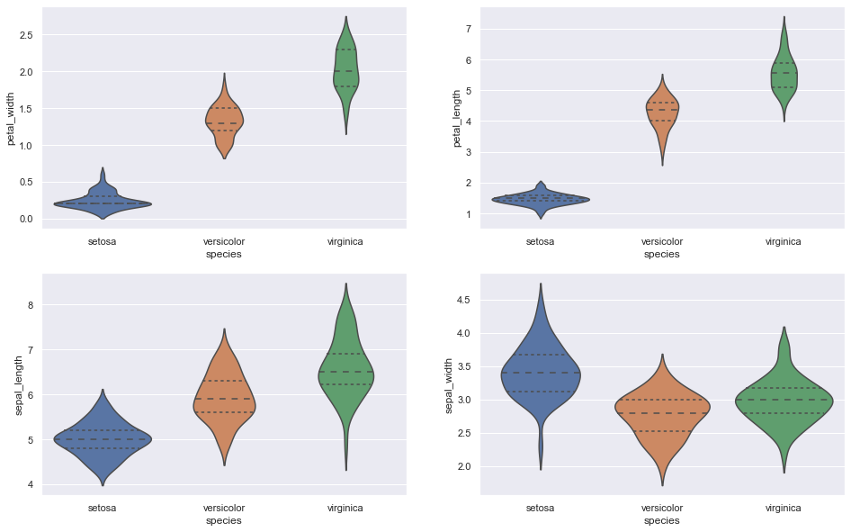

Slide 146
Data Insights:
Setosa is having less distribution and density in case of petal length & width
Versicolor is distributed in a average manner and average features in case of petal length & width
Virginica is highly distributed with large no .of values and features in case of sepal length & width
High density values are depicting the mean/median values, for example: Iris Setosa has highest density at 5.0 cm ( sepal length feature) which is also the median value(5.0) as per the table

Slide 147
Mean / Median Table for reference

Slide 148
Plotting the Histogram & Probability Density Function (PDF)
plotting the probability density function(PDF) with each feature as a variable on X-axis and it’s histogram and corresponding kernel density plot on Y-axis.

Slide 149
sns.FacetGrid(iris, hue="species", height=5) \ .map(sns.distplot, "sepal_length") \ .add_legend()
sns.FacetGrid(iris, hue="species", height=5) \ .map(sns.distplot, "sepal_width") \ .add_legend()
sns.FacetGrid(iris, hue="species", height=5) \ .map(sns.distplot, "petal_length") \ .add_legend()
sns.FacetGrid(iris, hue="species", height=5) \ .map(sns.distplot, "petal_width") \ .add_legend() plt.show()

Slide 150
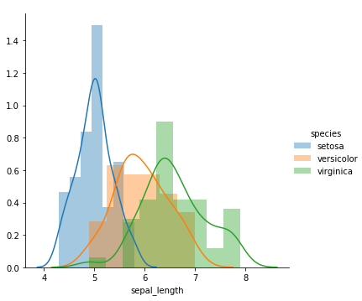
Plot 1 | Classification feature : Sepal Length

Slide 151
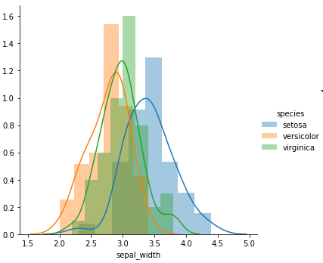
Plot 2 | Classification feature : Sepal Width

Slide 152
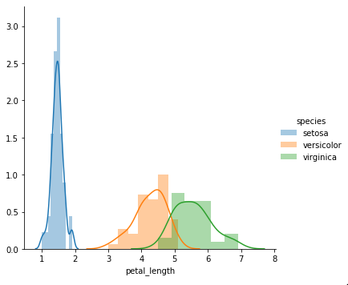
Plot 3 | Classification feature : Petal Length

Slide 153
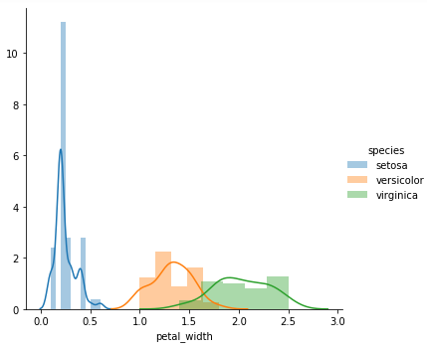
Plot 4 | Classification feature : Petal Width

Slide 154
Data Insights:
Plot 1 shows that there is a significant amount of overlap between the species on sepal length, so it is not an effective Classification feature
Plot 2 shows that there is even higher overlap between the species on sepal width, so it is not an effective Classification feature
Plot 3 shows that petal length is a good Classification feature as it clearly separates the species . The overlap is extremely less (between Versicolor and Virginica) , Setosa is well separated from the rest two
Just like Plot 3, Plot 4 also shows that petal width is a good Classification feature . The overlap is significantly less (between Versicolor and Virginica) , Setosa is well separated from the rest two

Slide 155
Choosing Plot 3 (Classification feature as Petal Length)to distinguish among the species
The pdf curve of Iris Setosa ends roughly at 2.1
Plot 3 | Classification feature : Petal Length

Slide 156
Data Insights:
The pdf curve of Iris Setosa ends roughly at 2.1
If petal length < 2.1, then species is Iris Setosa
The point of intersection between pdf curves of Versicolor and Virginica is roughly at 4.8
If petal length > 2.1 and petal length < 4.8 then species is Iris Versicolor
If petal length > 4.8 then species is Iris Virginica

Slide 157
Titanic Data EDA
Titanic Dataset – It is one of the most popular datasets used for understanding machine learning basics. It contains information of all the passengers aboard the RMS Titanic, which unfortunately was shipwrecked. This dataset can be used to predict whether a given passenger survived or not.
Conduct exploratory data analysis (EDA) and statistical modeling on the Titanic Dataset in order to gather insights and evenutally predicting survior(0 = Not Survived, 1 = Survived). Out of the 891 passengers that went on board the titanic, approximately 38% of them got surived where as majority 62% did not survive the disaster.
The csv file can be downloaded from https://www.kaggle.com/c/titanic/data

Slide 158
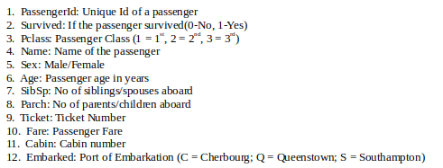

Slide 159
Features: The titanic dataset has roughly the following types of features:
Categorical/Nominal: Variables that can be divided into multiple categories but having no order or priority. Eg. Embarked (C = Cherbourg; Q = Queenstown; S = Southampton)
Binary: A subtype of categorical features, where the variable has only two categories. Eg: Sex (Male/Female)
Ordinal: They are similar to categorical features but they have an order(i.e can be sorted). Eg. Pclass (1, 2, 3)
Continuous: They can take up any value between the minimum and maximum values in a column. Eg. Age, Fare
Count: They represent the count of a variable. Eg. SibSp, Parch
Useless: They don’t contribute to the final outcome of an ML model. Here, PassengerId, Name, Cabin and Ticket might fall into this category.

Slide 160
PROCEDURE
Import the relevant python libraries for the analysis
Load the train and test dataset and set the index if applicable
Visually inspect the head of the dataset,Examine the train dataset to understand in particular if the data is tidy, shape of the dataset,examine datatypes, examine missing values, unique counts and build a data dictictionary dataframe
Run discriptive statistics of object and numerical datatypes, and finally transform datatypes accordingly
Carry-out univariate,bivariate and multivariate analysis using graphical and non graphical(some numbers representing the data) mediums
Feature Engineering : Extract title from name, Extract new features from name, age, fare, sibsp, parch and cabin
Preprocessing and Prepare data for statistical modeling
Statistical Modelling

Slide 161
Import the relevant python libraries for the analysis
import pandas as pd
import numpy as np
import matplotlib.pyplot as plt
import seaborn as sns
Load the train and test dataset and set the index if applicable
#load the train dataset d
df = pd.read_csv('train.csv')

Slide 162

#inspect the first few rows of the train dataset
df.head()
(891, 11)
df.shape

Slide 163
# identify datatypes
df.dtypes
PassengerId int64 Survived int64 Pclass int64 Name object Sex object Age float64 SibSp int64 Parch int64 Ticket object Fare float64 Cabin object Embarked object dtype: object

Slide 164
# identify missing values
df.isnull().sum()
PassengerId 0
Survived 0
Pclass 0
Name 0
Sex 0
Age 177
SibSp 0
Parch 0
Ticket 0
Fare 0
Cabin 687
Embarked 2
dtype: int64

Slide 165
# Identify number of unique values
df.nunique()
0 MissingVal NUnique
Survived int64 0 2
Pclass int64 0 3
Name object 0 891
Sex object 0 2
Age float64 177 88
SibSp int64 0 7
Parch int64 0 7
Ticket object 0 681
Fare float64 0 248
Cabin object 687 147
Embarked. object 2 3

Slide 166
df.describe()

Slide 167
Carryout univariate and multivariate analysis using graphical and non graphical(some numbers represting the data)
df.Survived.value_counts(normalize=True)
Output:
0 0.616162
1 0.383838
Name: Survived, dtype: float64
only 38% of the passengers were survived, where as a majority 61% the passenger did not survive the disaster

Slide 168
Univariate Analysis
fig, axes = plt.subplots(2, 4, figsize=(16, 10))
sns.countplot('Survived',data=df,ax=axes[0,0])
sns.countplot('Pclass',data=df,ax=axes[0,1])
sns.countplot('Sex',data=df,ax=axes[0,2])
sns.countplot('SibSp',data=df,ax=axes[0,3])
sns.countplot('Parch',data=df,ax=axes[1,0])
sns.countplot('Embarked',data=df,ax=axes[1,1])
sns.distplot(df['Fare'], kde=True,ax=axes[1,2])
sns.distplot(df['Age'].dropna(),kde=True,ax=axes[1,3])

Slide 169
Output:
<matplotlib.axes._subplots.AxesSubplot at 0x7ffa6366bdd8>

Slide 170
Bivariate EDA
We can clearly see that male survial rates is around 20% where as female survial rate is about 75% which suggests that gender has a strong relationship with the survival rates.
There is also a clear relationship between Pclass and the survival by referring to first plot below. Passengers on Pclass1 had a better survial rate of approx 60% whereas passengers on pclass3 had the worst survial rate of approx 22%
There is also a marginal relationship between the fare and survial rate.

Slide 171
figbi, axesbi = plt.subplots(2, 4, figsize=(16, 10))
df.groupby('Pclass')['Survived'].mean().plot(kind='barh',ax=axesbi[0,0],xlim=[0,1])
df.groupby('SibSp')['Survived'].mean().plot(kind='barh',ax=axesbi[0,1],xlim=[0,1])
df.groupby('Parch')['Survived'].mean().plot(kind='barh',ax=axesbi[0,2],xlim=[0,1])
df.groupby('Sex')['Survived'].mean().plot(kind='barh',ax=axesbi[0,3],xlim=[0,1])
df.groupby('Embarked')['Survived'].mean().plot(kind='barh',ax=axesbi[1,0],xlim=[0,1])
sns.boxplot(x="Survived", y="Age", data=df,ax=axesbi[1,1])
sns.boxplot(x="Survived", y="Fare", data=df,ax=axesbi[1,2])

Slide 173
Multivariate EDA
Construct a Coorelation matrix of the int64 and float64 feature types
There is a positve coorelation between Fare and Survived and a negative coorelation between Pclass and Surived
There is a negative coorelation between Fare and Pclass, Age and Plcass

Slide 174
import seaborn as sns
f, ax = plt.subplots(figsize=(10, 8))
corr = df.corr()
sns.heatmap(corr,
mask=np.zeros_like(corr, dtype=np.bool),
cmap=sns.diverging_palette(220, 10, as_cmap=True),
square=True, ax=ax)

Slide 176
Having missing values in a dataset can cause errors with some machine learning algorithms and either the rows that has missing values should be removed or imputed
Imputing refers to using a model to replace missing values.
There are many options we could consider when replacing a missing value, for example:
constant value that has meaning within the domain, such as 0, distinct from all other values.
value from another randomly selected record.
mean, median or mode value for the column.
value estimated by another predictive model.

Slide 177
# impute the missing Fare values with the mean Fare value
df.Fare.fillna(train.Fare.mean(),inplace=True)
# validate if any null values are present after the imputation
df[df.Fare.isnull()]

Slide 178
Statistical Modelling
df.columns
Output:
Index(['Survived', 'Pclass', 'Name', 'Sex', 'Age', 'SibSp', 'Parch', 'Ticket', 'Fare', 'Cabin', 'Embarked', 'Name_len', 'Ticket_First', 'FamilyCount', 'Cabin_First', 'title’], dtype='object')

Slide 179
trainML = df[['Survived', 'Pclass', 'Name', 'Sex', 'Age', 'SibSp', 'Parch', 'Ticket', 'Fare', 'Embarked', 'Name_len', 'Ticket_First', 'FamilyCount', 'title’]]
# drop rows of missing values
trainML = trainML.dropna()
# check the datafram has any missing values
trainML.isnull().sum()

Slide 180
Survived 0
Pclass 0
Name 0
Sex 0
Age 0
SibSp 0
Parch 0
Ticket 0
Fare 0
Embarked 0
Name_len 0
Ticket_First 0
FamilyCount 0
title 0
dtype: int64

Slide 181
Data Visualization using Tableau
Tableau is a Data Visualisation tool that is widely used for Business Intelligence but is not limited to it. It helps create interactive graphs and charts in the form of dashboards and worksheets to gain business insights. And all of this is made possible with gestures as simple as drag and drop
Tableau is a powerful and fastest growing data visualization tool used in the Business Intelligence Industry. It helps in simplifying raw data in a very easily understandable format. Tableau helps create the data that can be understood by professionals at any level in an organization. It also allows non-technical users to create customized dashboards.

Slide 182
Data analysis is very fast with Tableau tool and the visualizations created are in the form of dashboards and worksheets.
The best features of Tableau software are
Data Blending
Real time analysis
Collaboration of data

Slide 183

What Products does Tableau offer?

Slide 184

Tableau Product Suite
The Tableau Product Suite consists of
Tableau Desktop
Tableau Public
Tableau Online
Tableau Server
Tableau Reader

Slide 185
For a clear understanding, data analytics in Tableau tool can be classified into two section.
Developer Tools: The Tableau tools that are used for development such as the creation of dashboards, charts, report generation, visualization fall into this category. The Tableau products, under this category, are the Tableau Desktop and the Tableau Public.
Sharing Tools: As the name suggests, the purpose of these Tableau products is sharing the visualizations, reports, dashboards that were created using the developer tools. Products that fall into this category are Tableau Online, Server, and Reader.

Slide 186
Tableau Desktop
Tableau Desktop has a rich feature set and allows you to code and customize reports. Right from creating the charts, reports, to blending them all together to form a dashboard, all the necessary work is created in Tableau Desktop.
For live data analysis, Tableau Desktop provides connectivity to Data Warehouse, as well as other various types of files. The workbooks and the dashboards created here can be either shared locally or publicly.
Based on the connectivity to the data sources and publishing option, Tableau Desktop is classified into
Tableau Desktop Personal: The development features are similar to Tableau Desktop. Personal version keeps the workbook private, and the access is limited. The workbooks cannot be published online. Therefore, it should be distributed either Offline or in Tableau Public.
Tableau Desktop Professional: It is pretty much similar to Tableau Desktop. The difference is that the work created in the Tableau Desktop can be published online or in Tableau Server. Also, in Professional version, there is full access to all sorts of the datatype. It is best suitable for those who wish to publish their work in Tableau Server.

Slide 187
Tableau Public
It is Tableau version specially build for the cost-effective users. By the word “Public,” it means that the workbooks created cannot be saved locally; in turn, it should be saved to the Tableau’s public cloud which can be viewed and accessed by anyone.
There is no privacy to the files saved to the cloud since anyone can download and access the same. This version is the best for the individuals who want to learn Tableau and for the ones who want to share their data with the general public.

Slide 188
Tableau Server
The software is specifically used to share the workbooks, visualizations that are created in the Tableau Desktop application across the organization. To share dashboards in the Tableau Server, you must first publish your work in the Tableau Desktop. Once the work has been uploaded to the server, it will be accessible only to the licensed users.
However, It’s not necessary that the licensed users need to have the Tableau Server installed on their machine. They just require the login credentials with which they can check reports via a web browser. The security is high in Tableau server, and it is much suited for quick and effective sharing of data in an organization.
The admin of the organization will always have full control over the server. The hardware and the software are maintained by the organization.

Slide 189
Tableau Online
As the name suggests, it is an online sharing tool of Tableau. Its functionalities are similar to Tableau Server, but the data is stored on servers hosted in the cloud which are maintained by the Tableau group.
There is no storage limit on the data that can be published in the Tableau Online. Tableau Online creates a direct link to over 40 data sources that are hosted in the cloud such as the MySQL, Hive, Amazon Aurora, Spark SQL and many more.
To publish, both Tableau Online and Server require the workbooks created by Tableau Desktop. Data that is streamed from the web applications say Google Analytics, Salesforce.com are also supported by Tableau Server and Tableau Online.

Slide 190
Tableau Reader
Tableau Reader is a free tool which allows you to view the workbooks and visualizations created using Tableau Desktop or Tableau Public. The data can be filtered but editing and modifications are restricted. The security level is zero in Tableau Reader as anyone who gets the workbook can view it using Tableau Reader.
If you want to share the dashboards that you have created, the receiver should have Tableau Reader to view the document.

Slide 191
How does Tableau work?
Tableau connects and extracts the data stored in various places. It can pull data from any platform imaginable. A simple database such as an excel, pdf, to a complex database like Oracle, a database in the cloud such as Amazon webs services, Microsoft Azure SQL database, Google Cloud SQL and various other data sources can be extracted by Tableau.
When Tableau is launched, ready data connectors are available which allows you to connect to any database. Depending on the version of Tableau that you have purchased the number of data connectors supported by Tableau will vary.

Slide 192
The pulled data can be either connected live or extracted to the Tableau’s data engine, Tableau Desktop. This is where the Data analyst, data engineer work with the data that was pulled up and develop visualizations. The created dashboards are shared with the users as a static file. The users who receive the dashboards views the file using Tableau Reader.
The data from the Tableau Desktop can be published to the Tableau server. This is an enterprise platform where collaboration, distribution, governance, security model, automation features are supported. With the Tableau server, the end users have a better experience in accessing the files from all locations be it a desktop, mobile or email.

Slide 193
Tableau Uses- Following are the main uses and applications of Tableau:
Business Intelligence
Data Visualization
Data Collaboration
Data Blending
Real-time data analysis
Query translation into visualization
To import large size of data
To create no-code data queries
To manage large size metadata

Slide 194
Excel Vs. Tableau
Both Excel and Tableau are data analysis tools, but each tool has its unique approach to data exploration. However, the analysis in Tableau is more potent than excel.
Excel works with rows and columns in spreadsheets whereas Tableau enables in exploring excel data using its drag and drop feature. Tableau formats the data in Graphs, pictures that are easily understandable.

Slide 195
Parameters | Excel | Tableau
Purpose | Spreadsheet application used for manipulating the data. | Perfect visualization tool used for analysis.
Usage | Most suitable for statistical analysis of structured data. | Most suitable for quick and easy representation of big data which helps in resolving the big data issues.
Performance | Moderate speed with no option to quicken. | Moderate speed with options to optimize and enhance the progress of an operation.
Security | The inbuilt security feature is weak when compared to Tableau. The security update needs to be installed on a regular basis. | Extensive options to secure data without scripting. Security features like row level security and permission are inbuilt.
User Interface | To utilize excel to full potential, macro and visual basic scripting knowledge is required. | The tool can be used without any coding knowledge.
Business need | Best for preparing on-off reports with small data | Best while working with big data.
Products | Bundled with MS Office tools | Comes with different versions such as the Tableau server, cloud, and desktop.

Slide 196
Integration | Excel integrates with around 60 applications | Tableaus integrated with over 250 applications
Real time data exploration | When you are working in excel, you need have an idea of where your data takes you to get to know the insights | In Tableaus, you are free to explore data without even knowing the answer that you want. With the in-built features like data blending and drill-down, you will be able to determine the variations and data patterns.
Easy Visualizations | When working in excel, we first manipulate the data that is present and then the visualization such as the different charts, graphs are created manually. To make the visualizations easily understandable, you should understand the features of excel well. | Whereas in Tableau, the data is visualized from the beginning.

Slide 197

Installing Tableau on your System
Tableau provides us various services according to our business need Tableau Desktop, Tableau Public, and Tableau Online, all these offer Data Visual Creation. Choice of Tableau depends upon the type of work.
Variants of Tableau
Tableau Desktop is a program that allows you to execute complicated data analysis tasks and generate dynamic, interactive representations to explain the results. Tableau also lets you share your analysis and visualizations with the rest of your company, allowing everyone from coworkers to top management to look into the data that matters to them.

Slide 198

After installation, if you find this Homescreen you are good to go:

Slide 199

Load Data in Tableau
We will be using global superstore data which is perfect for learning purposes.

Slide 200


Slide 201
Tableau supports various data formats which can be loaded by choosing those options. Under a file we see various options to load data from the local directory and under to a server, we see options to load data from cloud servers. for loading CSV files we select Text file options, for excel and SQL files we choose their respective options.
Connect Tableau to the data file:
To open the application, click the Tableau icon on your desktop (or in your Start menu).
In the Connect panel at the left side of the Start page, click the Excel link under the “To a File” heading to the open file selection option.
Using the file selection box, select the Excel worksheet that you want to open, and then click the Open button to continue
Select the Orders sheet from the navigation menu on the left and drag it onto the Drag Sheets Here area, as shown in the above gif.
After loading we can perform data cleaning, data preprocessing, feature extraction to some extent.

Slide 202

Understanding different Sections in Tableau
Tableau loaded with global-superstore data and now we can see Tableau work-page.
Tableau work-page consist of different section.

Slide 203
Source: Local
Menu Bar: Here you’ll find various commands such as File, Data, and Format.
Toolbar Icon: The toolbar contains a number of buttons that enable you to perform various tasks with a click, such as Save, Undo, and New Worksheet.
Dimension Shelf: This shelf contains all the categorical columns under it. example: categories, segments, gender, name, etc
Measure Shelf: This shelf contains all numerical columns under it like profit, total sales, discount, etc
Page Shelf: This shelf is used for joining pages and create animations. we will come on it later
Filter Shelf: You can choose which data to include and exclude using the Filters shelf, for example, you might want to analyze the profit for each customer segment, but only for certain shipping containers and delivery times. You may make a view like this by putting fields on the Filters tier.
Marks Card: The visualization can be designed using the Marks card. The markings card can be used to change the data components of the visualization, such as color, size, shape, path, label, and tooltip.
Worksheet: In the workbook, the worksheet is where the real visualization may be seen. The worksheet contains information about the visual’s design and functionality.

Slide 204

Data Source: Using Data Source we can add new data, modify, remove data.
Current Sheet: The current sheets are those sheets which we have created and to those, we can give some names.
New Sheet: If we want to create a new worksheet ( blank canvas ) we can do using this tab.
New Dashboard: This button is used to create a dashboard canvas.
New Storyboard: It is used to create a new story

Slide 205
Creating Visuals in Tableau
Let’s begin with the real data visualization using Tableau-
Tableau supports the following data types:
Boolean: True and false can be stored in this data type.
Date/Datetime: This data type can help in leveraging Tableau’s default date hierarchy behavior when applied to valid date or DateTime fields.
Number: These are values that are numeric. Values can be integers or floating-point numbers (numbers with decimals).
String: This is a sequence of characters encased in single or double quotation marks.
Geolocation: These are values that we need to plot maps.

Slide 206


Slide 207
Follow these steps:
drag the dimension and measure in row and column input field and it will automatically suggest a graph best fitted on data.
you can change the graph by clicking on the show me button and select whichever graph you want.
you can also remove the axis just by dragging and dropping them under the marks card (remove field).
Show Me: When you click this label, a palette appears, giving you rapid access to many options for showing the selected types of fields. The palette changes depending on the fields in the worksheet you’ve selected or are active.

Slide 208

From the above image, you might have observed that the default aggregation on the measure is sum but you can change the aggregation to sum, avg, min, max, etc, you can also customize the axis name, orientation, size, show-hide axis

Slide 209
Enhancing the Analysis:
In order to create a beautiful interactive visual, you must understand the following features:
a. Marks card
Marks card is very important for plotting graphs. In marks card we have:
Colour button which is used to give different colors to different categories and measures,
Size button is used to give size which depends on how big a value is. The bigger the value means bigger the size of a particular mark
Label button which is used to show labels to graphs, clicking on the label button throws us some settings where you can set the formatting of labels.
Tooltips, here you can add information like ( profit, quantity, sales, discount, category, state, etc.) which will be visible on hovering over the graph
The Details button allows you to display more information without affecting the table’s structure. which is used to show details about particular points. dragging a field on details buttons will show the details of that point, and this feature is majorly used for maps to show more details of a particular point.

Slide 210


Slide 211
b. Filter
After creating some plots you might want to use different filters, to do so follow these steps:
On the filter shelf, you can drag any measure or dimension whichever you want to apply a filter on.
As you drop the field a box will appear, now you can select any particular category, or top-n rows according to measure values or you can write some rules to select top rows or by using some parameters.
Now click on show filter after selecting the filter you just applied.
You may want to apply multiple filters, to do so you will need to add previous filters into context by clicking on add to context here Context Filter is a Tableau filter that is applied before all other filters. You can choose different options standard, fit width, fit height, entire view from the toolbar in order to fit the visualization into the worksheet.
c. Hierarchy
You can quickly establish hierarchies with Tableau to keep your data organized.
Hierarchy is basically nesting the same type of related data together. Tableau calendar data is an example of a hierarchy.

Slide 212

Date-time, calendar is in the form of hierarchy in Tableau, which can be drilled down to year -> quarter ->month -> day by clicking on the “+” button on the features tab,
You also can create your own hierarchy like country -> state -> city -> postal code, just by dragging features to another and when needed clicking on ‘+’ button you can drill down further to city, state, postal code.

Slide 213

d. Parameter
A parameter is a workbook variable like a number, date, or string that can be readily managed by the user to replace a constant value in a calculation.

Slide 214
In the above image, our goal was to choose the top N countries having maximum sales but here we wanted to let the user select how many top countries they want to list. To accomplish so, we’ll need to create the following parameters:
Click the down arrow to the right of Dimensions in the Data pane and select Create Parameter from the pop-up menu that appears, as shown in the above image. and give a name variable1.
Select a data type from the Data Type drop-down menu, in my case, I have chosen to int range from 1–100 list and the current value will be 5.
Click on show parameter will show the parameter with a slider. but it hasn’t yet connected with any working.
Here we wanted to choose top-N countries based on the sales. drag country field to filter shelf and choose top tab and then choose variable1 in by field section and choose SUM(SALES).
Now slide the parameter value and observe the difference.

Slide 215
e . Calculated field
Tableau gives us the option to create a calculated field where we can create our own new field( column). Tableau comes with many functions like if-else, switch, case, date diff, level of dimension which is extensively used for our visualization
To segment data
level of details(LOD)
To change a field’s data type, for example, from a string to a date.
To aggregate data
handling date time
To filter results
To calculate ratios

Slide 216


Slide 217
Creating Calculated Field:
Here our goal is to calculate delivery days using order date and ship date:
Select Analysis > Create Calculated Field and give the name delivery days
Give the Rule to calculate delivery days in the rule box. here we will use the DATEDIFF function to subtract two dates.
Type Rule: delivery days = DATEDIFF(‘day’, [shipdate],[order date])
now drag the delivery days field in rows or cols.

Slide 218
f. Format
Formatting in Tableau is very easy. Just click on the format button wherever you want to format. we can format text, numbers, percentage, decimals, date-time format, label color, label size, axis line color, worksheet, columns, header, etc . as shown in the above image.
Data Analytics in Tableau
In the Analytics tab, we have several analytical tools like forecasting, clustering, trend line, Average line, constant line, etc.

Slide 219


Slide 220
Steps to perform Analytics
From the Analytics tab on the left side, you can choose various options.
Dragging and dropping a constant line on a particular X, or Y-axis draws a line at a given constant value.
Dragging forecast on your sheet will give you a time forecasting of a given measure, which you can edit by clicking right click on the forecasted part, there you can choose the confidence interval, time steps to be forecasted and forecast model, etc.
The trend line is not the same as forecasting. The trend line only tells us if the overall trend is increasing or decreasing.

Slide 221
Summary on Tableau
Tableau definition or Tableau meaning: Tableau is a powerful and fastest growing data visualization tool used in the Business Intelligence Industry.
The Tableau Product Suite consists of 1) Tableau Desktop 2) Tableau Public 3) Tableau Online 4) Tableau Server and Tableau Reader.
Tableau Desktop has a rich feature set and allows you to code and customize reports.
In Tableau public, workbooks created cannot be saved locally, in turn, it should be saved to the Tableau’s public cloud which can be viewed and accessed by anyone.
Tableau server is specifically used to share the workbooks, visualizations that are created in the Tableau Desktop application across the organization.
Tableau online has all the similar functionalities of the Tableau Server, but the data is stored on servers hosted in the cloud which are maintained by the Tableau group.
Tableau Reader is a free tool which allows you to view the workbooks and visualizations created using Tableau Desktop or Tableau Public.
Tableau connects and extracts the data stored in various places. It can pull data from any platform imaginable.
The spreadsheet application used for manipulating the data while Tableau is a perfect visualization tool used for analysis.

Slide 222
THANK YOU

